Slide 1

personal identification module

Slide 2
Contents
Introduction
Orange HRM intro
What and Why
Modules of Orange HRM
PIM module
PIM intro
Features of PIM
Few screenshots of Orange HRM
Conclusion

Slide 3
Introduction
HR management system that offers a wealth of modules to suit the needs of your business.
Orange HRM
Open source
Professional
Enterprise

Slide 4
Open source Orange HRM
Orange HRM Open Source is a free HR management system
Feature-rich
Intuitive
Free documentation and access to a broad community of users.

Slide 5
Orange HRM professional
Orange HRM Professional is a module-based.
Full-service HR solution for small- to medium- sized businesses operating in a single country.
OrangeHRM Professional offers superior management and cost efficiencies across the board.

Slide 6
Orange HRM Enterprise
Enterprise edition is a robust and scalable system with configurable workflows.
Custom reports
Advanced rule-based engines
Superb customer support

Slide 7
Modules of Orange HRM
System Administration
Personnel Information Management (PIM)
Leave /Time off Management
Time & Attendance Management
Recruitment
Performance
Employee Self Service
DASHBOARD

Slide 8

Personal Identification Module

Slide 9
PIM – Personal Identification Module
Personal information management (PIM) is a basic function of any HR department.
PIM module should provide all relevant employee related information and should be available to the admin with full access/control.

Slide 10
PIM feature(s):
It is a centralized location where all personal details about a employee is stored.
PIM
Detail 1
Detail 2
Detail 3
Detail 4

Slide 11
PIM feature(s):
Details can be stored in PIM ( Personal Identification Module ) are like :
Employee name
Employee personal details
Employee educational qualifications
Employee work experience
Employee pay grade and his/her salary
Employee dependent details
Employee passport/visa details and etc.,

Slide 12
PIM feature(s):
Information captured in this module should be utilized by all the other modules, thus eliminating data redundancy.
The information can be saved in PIM via two methods i.e. either uploading a CSV file or typing and saving the info manually in software.
Details
Manual entry
Export a CSV

Slide 13
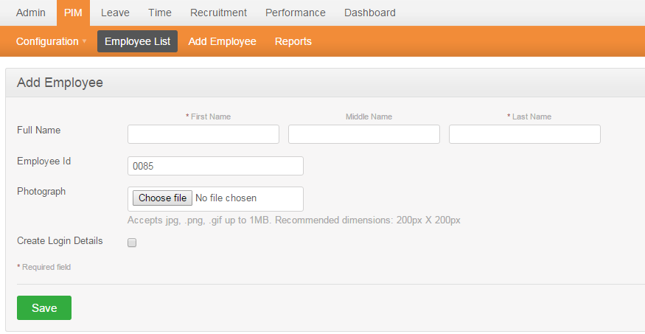
Screenshot(s):
Adding a new employee

Slide 14
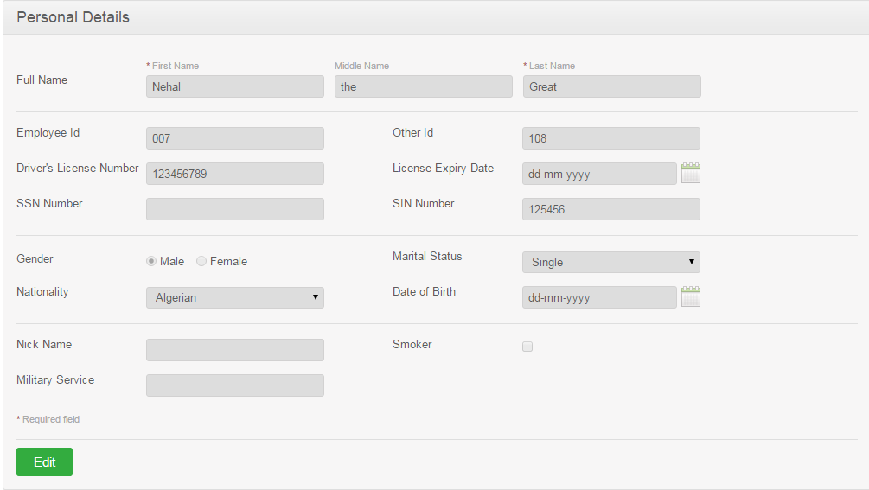
Screenshot(s):
Adding / Updating personal details

Slide 15
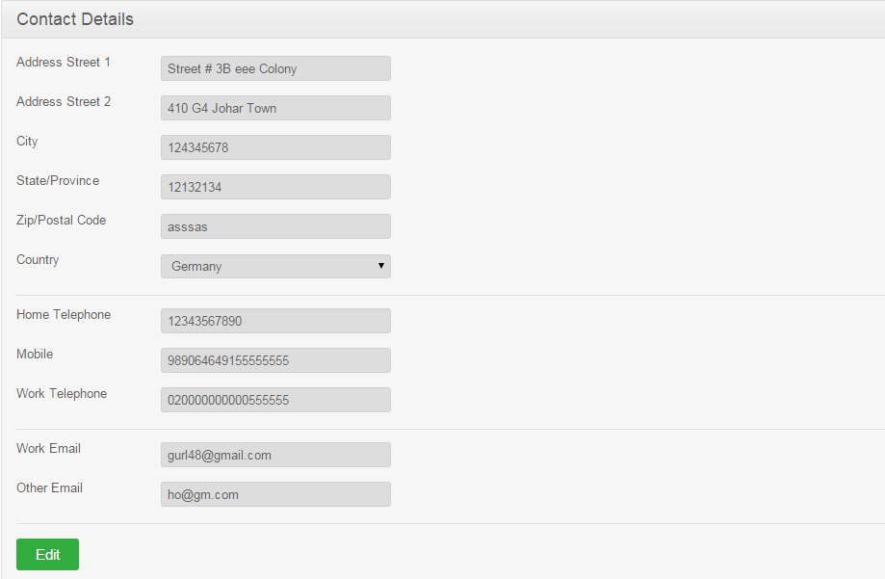
Screenshot(s):
Adding / Updating contact details

Slide 16
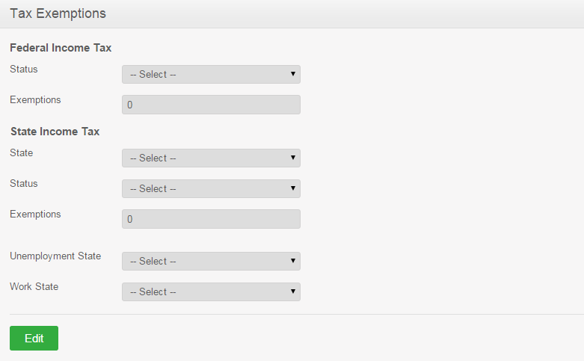
Screenshot(s):
Adding / Updating Tax exemption details

Slide 17
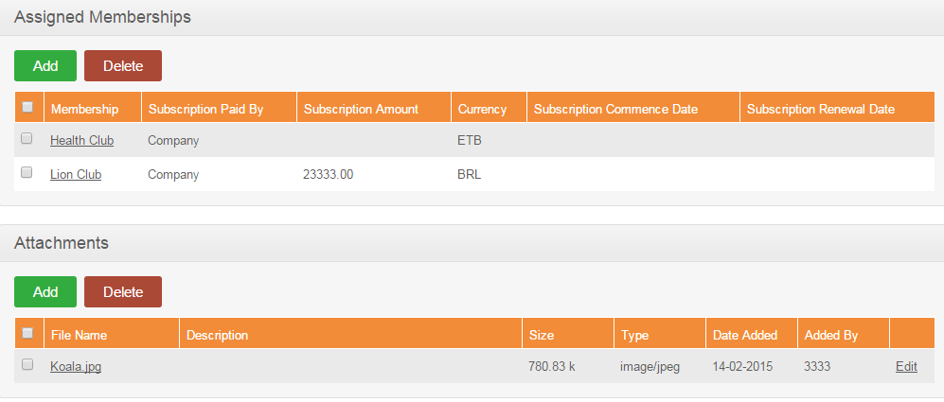
Screenshot(s):
Assigning memberships and Attachments

Slide 18
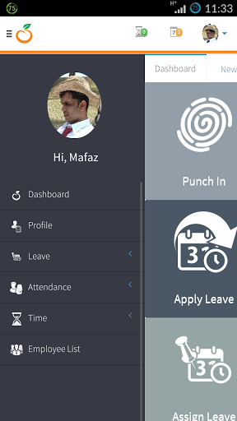

Screenshot(s):
OrangeHRM
Corporate Directory

Slide 19
Conclusion
Orange HRM has been researching and working on a way to produce a cost effective system to re-engineer a corporate HR process

Slide 20
Conclusion
Give a try in the side given link to test the product
When you need to rapidly on-board a full-service HR environment, Orange HRM meets your business and budget requirements.
http://opensource.demo.orangehrm.com/

Slide 21


